Slide 1

Data Mining as a BI Tool
Data Extraction
Collecting / Transforming
Data Storage
Storing / Aggregating / Historising
Business Intelligence
Visualisation
Reporting / EIS / MIS
Data Analysis
Exploration
OLAP
Discovery
Data Mining
Notes:
The slide to remember
New business or existing business
Drivers:
reduce costs
sell more
improve the service
=> Bring all of you through these steps

Slide 2
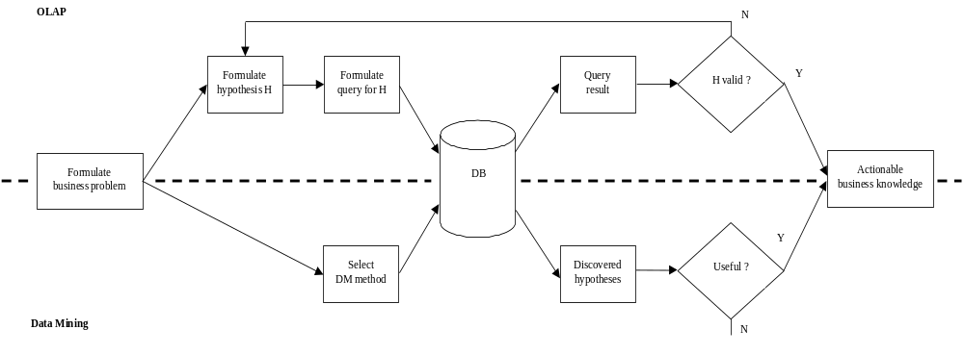
OLAP vs. Data Mining
OLAP verifies hypotheses – The analyst intuits at the result and guides the process
Data Mining discovers hypotheses – The data determine the results

Slide 3






Input-Output View
Data Mining
Data
(internal & external)
Reports
Objective(s)
Decision Models
Business Knowledge
New Knowledge

Slide 4
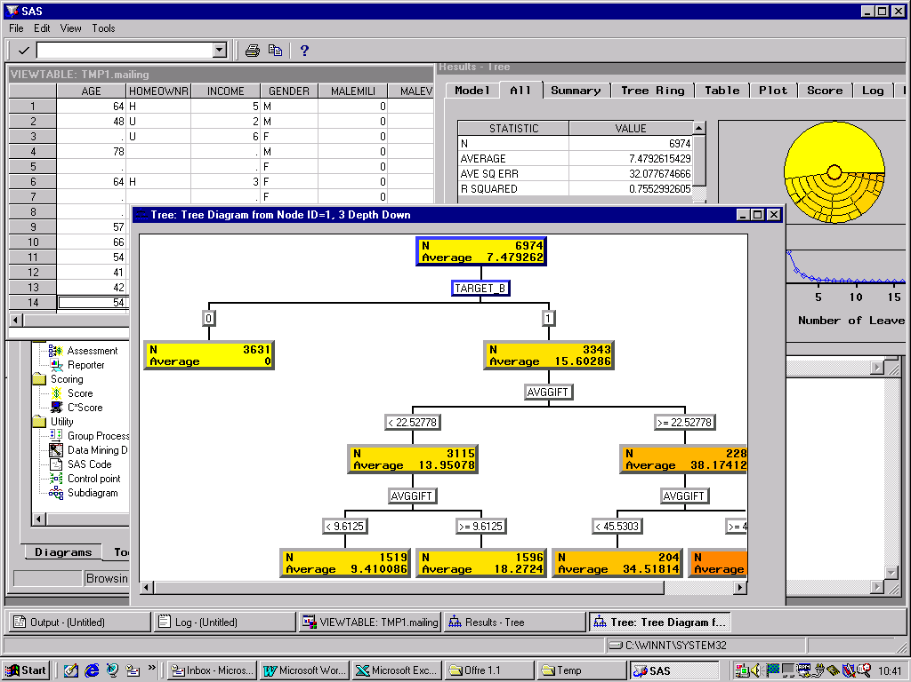
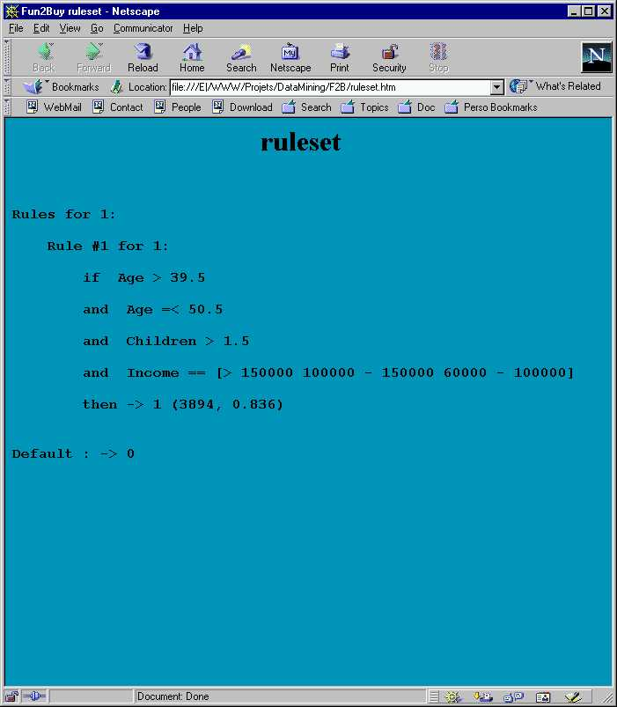
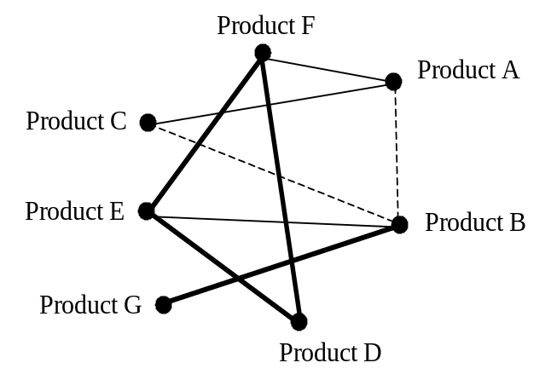
What Kind of Output?
Decision trees
Rules
Web

Slide 5
Data Mining
Operationalization of Machine Learning, with two specific emphases
  Emphasis on process
  Emphasis on action

Slide 6

From Data to Action
Knowledge
People who buy product X also buy product Y, P% of the time
Doctors who perform in excess of N operations of type T per month may be fraudulous
Molecules of class X are most likely carcinogenic
Actions
Offer product Y to owners of product X
Investigate potential frauds
Information
Mrs X buys product Y
Product X costs Y francs
Mr X drives a car of type Y
Dr X performed Y operations
of type T
Data (raw)
Lifestyle
Transactions
Socio-demographics

Slide 7
Process View
Interpretation
Check against hold-out set
&
Evaluation
Build a decision tree
Model
Dissemination
Building
&
Deployment
Aggregate individual incomes into household income
Learn about loans, repayments, etc.;
Collect data about past performance
Data
Pre-processing
Patterns
Determine credit worthiness
Domain & Data
Models
Understanding
Business
Problem
Pre-processed
Formulation
Data
Selected
Data
Raw
Data

Slide 8
Key Success Factors
Have a clearly articulated business problem that needs to be solved and for which Data Mining is the adequate technology
Ensure that the problem being pursued is supported by the right type of data of sufficient quality and in sufficient quantity
Recognise that Data Mining is a process with many components and dependencies
Plan to learn from the Data Mining process whatever the outcome

Slide 9
Myths (I)
Data Mining produces surprising results that will utterly transform your business
  Reality:
    Early results = scientific confirmation of human intuition.
    Beyond = steady improvement to an already successful organisation.
    Occasionally = discovery of one of those rare « breakthrough » facts.
Data Mining techniques are so sophisticated that they can substitute for domain knowledge or for experience in analysis and model building
  Reality:
    Data Mining = joint venture.
    Close cooperation between experts in modeling and using the associated techniques, and people who understand the business.

Slide 10
Myths (II)
Data Mining is useful only in certain areas, such as marketing, sales, and fraud detection
  Reality:
    Data mining is useful wherever data can be collected.
    All that is really needed is data and a willingness to « give it a try. » There is little to loose…
Only massive databases are worth mining
  Reality:
    A moderately-sized or small data set can also yield valuable information.
    It is not only the quantity, but also the quality of the data that matters (characterising mutagenic compounds)

Slide 11
Myths (III)
The methods used in Data Mining are fundamentally different from the older quantitative model-building techniques
  Reality:
    All methods now used in data mining are natural extensions and generalisations of analytical methods known for decades.
    What is new in data mining is that we are now applying these techniques to more general business problems.
Data Mining is an extremely complex process
  Reality:
    The algorithms of data mining may be complex, but new tools and well-defined methodologies have made those algorithms easier to apply.
    Much of the difficulty in applying data mining comes from the same data organisation issues that arise when using any modeling techniques.

Slide 12
OLAP vs. DM Illustration

Slide 13
Data Mining with OLAP (I)
Formulate hypothesis
  Beer and fish sell well together
Issue corresponding queries
  TC = select COUNT of all baskets containing both beer and fish
Decide on validity
  Ratio of TC over baskets containing only beer or only fish, AND other possible associations

Slide 14
Data Mining with OLAP (II)
Assume 11 possible products in any one basket and restrict to associations of at most 4 products
  55 possible associations of 2 products
  165 possible associations of 3 products
  330 possible associations of 4 products
Must issue 550 queries and compare the results!!!

Slide 15
Data Mining Instead of OLAP
Only two alternatives with OLAP:
  Brute force: prohibitive!
  Intuition: speculative!
Data Mining strikes a balance:
  Try most associations
  Use heuristics to guide the search
DM increases chances of useful discovery!

